Slide 1
Text Summarization
By: Team 12
Isha Arora
Akshay Chopra
Shivalik Narad Preksha Raj Shimoga Basavaraja

Slide 2

INTRODUCTION
Too long; didn't read (tl;dr)
For the long articles and blog posts which you are interested in but sometimes you just need a gist
Here we present two different algorithms to create a summary for the long text that you want to read!
Summarizers Implemented:
Text-rank
Lex-rank

Slide 3
DATA COLLECTION
Data is collected by the following sources-
https://github.com/kylehg/summarizer/tree/master/input
The corpus is a transcript of news articles collected from APW and New York Times
After the data was collected we preprocessed the data in the following way
cleaned the data
removed the trailing white spaces
split the data into lines
removed the punctuations and numbers from each line
tokenized the lines
then split the links into tokens and stemmed the words-used for 2nd approach.

Slide 4
TEXTRANK
The input file is preprocessed to return a list of sentences
Based on this list of sentences create a graph
In the Graph each node is marked with each sentence
The similarity between each sentences is calculated and is assigned as weights of edges between the nodes
The page rank is applied to each node to get the rank of each node (sentence)
The topmost rank sentences is returned as the summary

Slide 5
SECOND APPROACH
The first approach used gave the summary based on the topmost ranked sentences
We also worked an approach to give the topmost keywords that summarize the article.
The input lines is split into tokens and tokens are assigned as nodes.
Then pagerank is applied to this graph to get the top ranked keywords.
The top ranked keywords are returned as the keyword summary.
Summary can also be extracted as a percentage of the article size.

Slide 6
LEX RANK
Text Rank implements page rank algorithm but it doesn’t take into consideration the how important is a word!
Lex rank features:
Ranks the sentences based on words that it contains
Word importance taken into consideration while ranking (tf-idf scores)
Lex-Rank algorithm can work for multi-document summarisation

Slide 7
LEX RANK Contd..
Preprocessing required:
Sentence extraction from paragraphs
Tokenization of sentences to words
Stemming the words
Stop words elimination
Calculate tf-idf metrics for words in the document corpus
Rank the sentences using the above metrics
Produce summary based on the sentence ranking

Slide 8
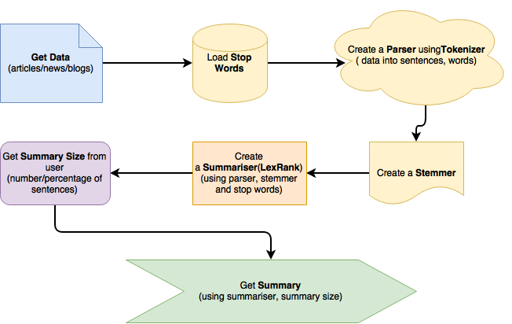
LEX RANK Simplified

Slide 9
REFERENCE SUMMARIES
Developed the script to get other reference summary for comparison.
Made an API call to the python package called SUMY to retrieve summaries based on sentence count.
Got the summary of SUMY-Textrank and SUMY-LexRank giving the filename as the input
Specify the sentence count
These summaries are considered as the reference summary to compare.

Slide 10
EVALUATE RESULTS-ROGUE
The sentences retrieved from the SUMY API text-rank is compared with the our text-rank implementation.
The sentences retrieved from the SUMY API lex-rank is compared with the our lex-rank implementation.
Also the summaries generated by tex-trank and lex-rank are compared to evaluate which algorithm is efficient for text summarization based on rogue metrics.

